Slide 1

The Inspector General Assistance Function
“We’re here to help.”
Part Two

Slide 2
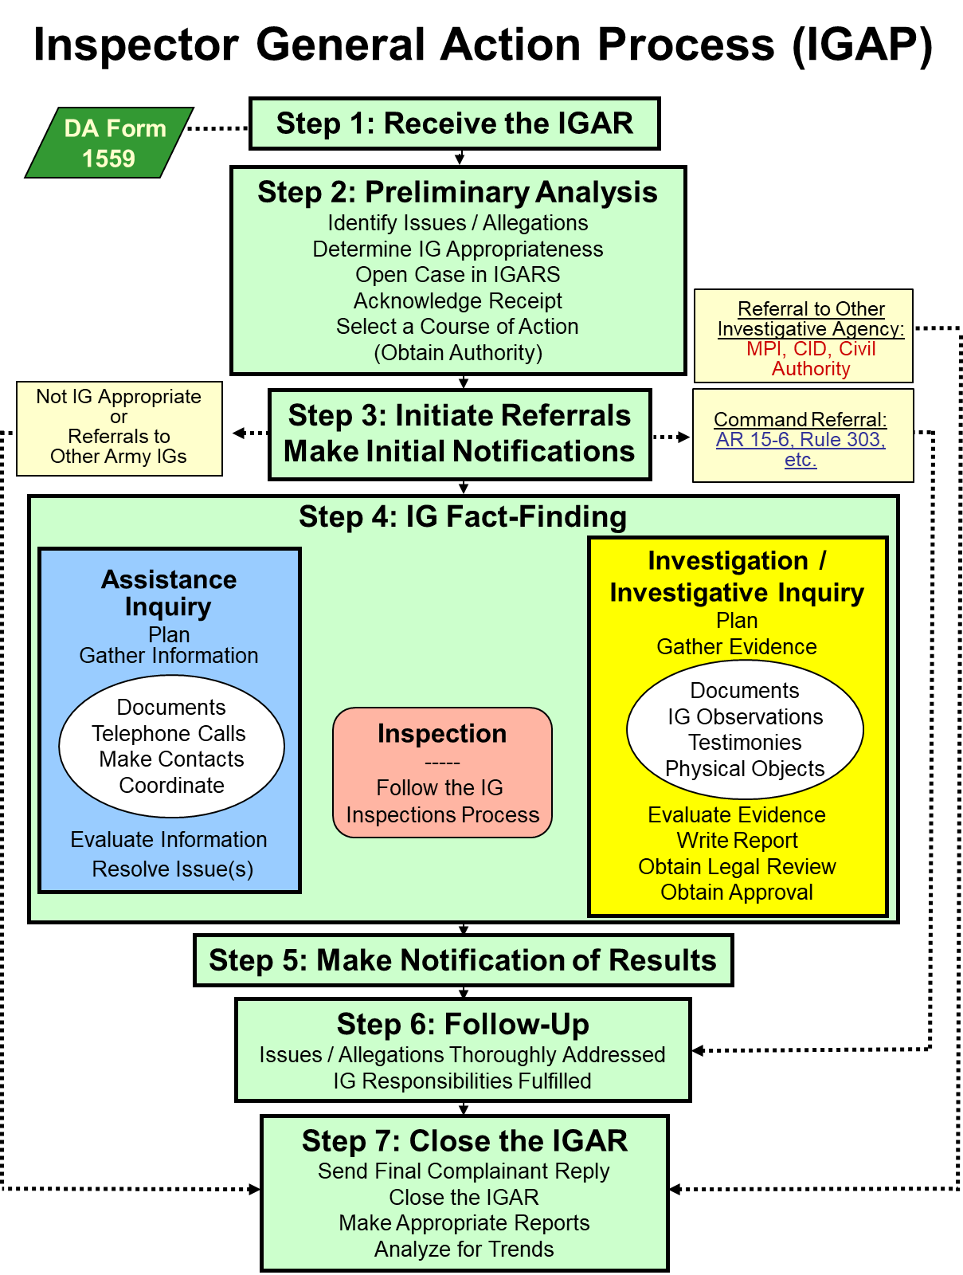
Inspector General Action Process (IGAP)
ELO
3
A&I Guide, Part One, Chapter 2
AR 20-1, para. 6-1

Slide 3
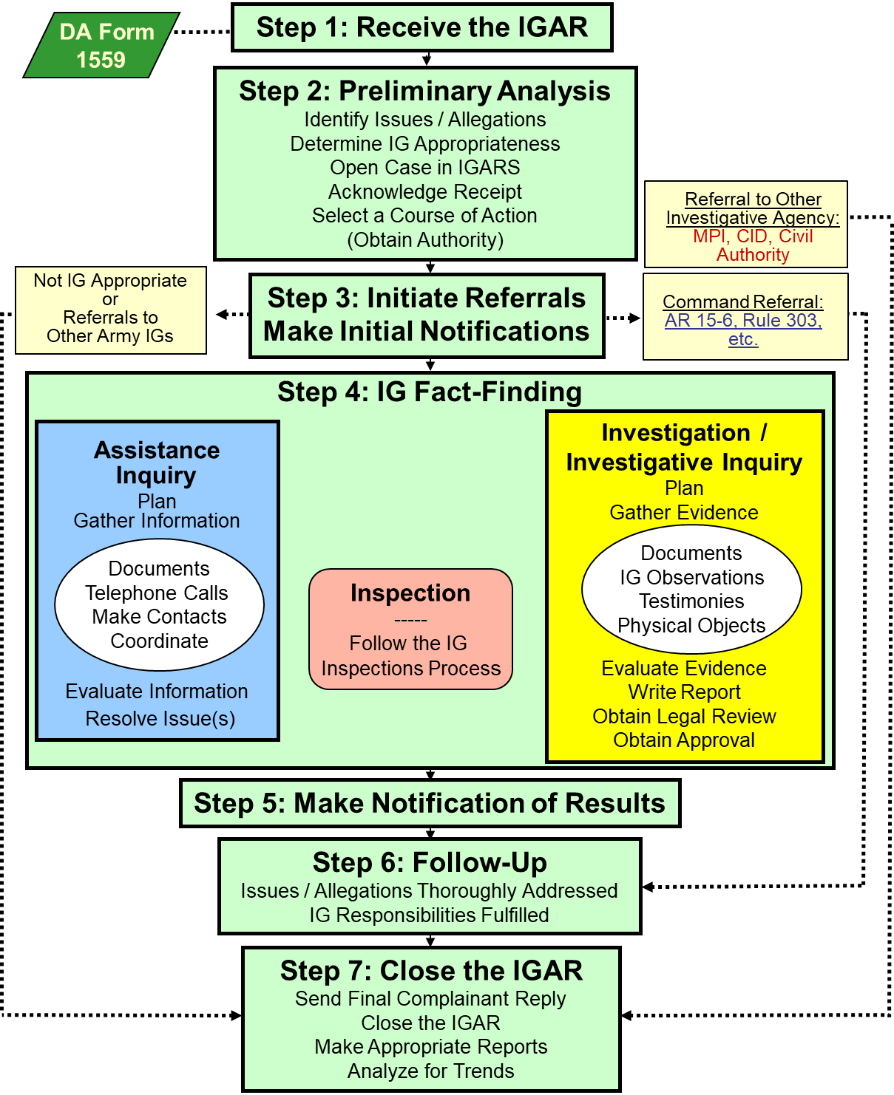
The Seven-Step IGAP
Step One
Step 1 Receive the IGAR
AR 20-1, para. 6-1d (1)
A&I Guide, Part One, Sect. 2-2

Slide 4
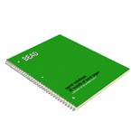
STEP 1: Receive the IGAR
IGARs come from the in crowd:
  Walk-in
  Call-in
  Write-in
  E-mail-in
  In the Gym / PX
A&I Guide, Part One, Sect. 2-2

Slide 5
STEP 1: Receive the IGAR
Private area
Put complainant at ease
Establish rapport but don’t buy in or be an advocate
Actively listen
Maintain control
Remember: Each story has at least sides
three
  Complainant
  Other person
  Truth
A&I Guide, Part One, Sect. 2-2

Slide 6
STEP 1: Receive the IGAR
Fundamental interview questions to ask:
  1. What do you want the IG to do for you?
  2. Do you have any supporting documentation?
  3. Is the chain of command aware of this issue?
  4. Have you asked or contacted any other source or agency for assistance?
  5. What is your status?
A&I Guide, Part One, Sect. 2-2-1

Slide 7
STEP 1: Receive the IGAR
Complete the DA Form 1559
  IG or Complainant
Advise of Privacy Act
  Disclosure of DOD ID is voluntary
  unless needed to resolve issue
IGs can assist in drafting
Read back and clarify to
ensure issues are understood
Have complainant sign
Do I need to complete this form?

Slide 8

STEP 1: Receive the IGAR
End the interview without commitment except to say that:
  We will look into the matter
  We will provide a response (if not 3rd party)
Complainant may have a copy of the DA Form 1559
A&I Guide, Part One, Sect. 2-2-1

Slide 9

STEP 1: Receive the IGAR
Call-Ins
Review / Read Privacy Act
Read back the DA Form 1559
Write “Telephonic” in Block 16: IG / Intake Remarks of the DA Form 1559
Ask for written follow-up if necessary
  Supporting documents
A&I Guide, Part One, Sect. 2-2-2

Slide 10
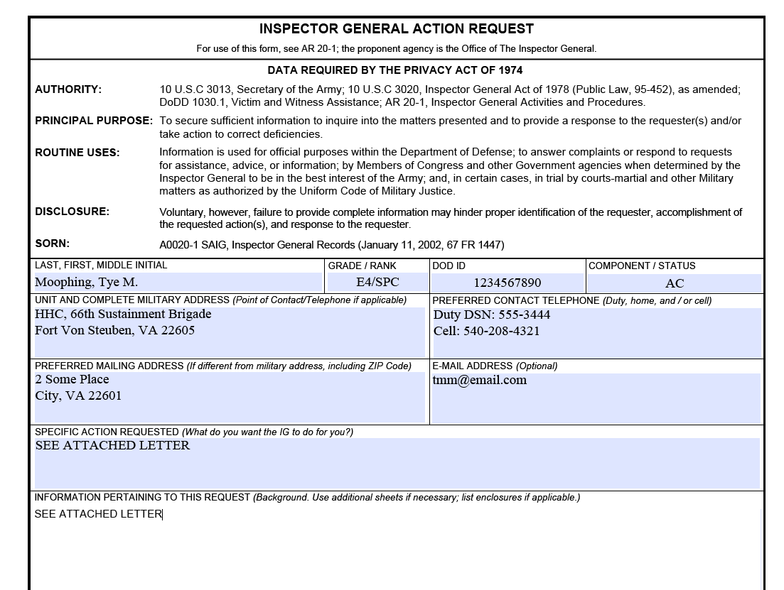
STEP 1: Receive the IGAR Write-Ins
No need to transfer information to DA Form 1559
See Attached Letter
A&I Guide, Part One,
Sect. 2-2-3

Slide 11

STEP 1: Receive the IGAR
E-mail
Treat as a "call-in" complaint
Respond in a new message
Request an address and phone number
Use a generic subject line
    “Your E-mail”
    NOT “Your IG Complaint”
AR 20-1, para. 6-1f.(4)
A&I Guide, Part One, Sect. 2-2-4

Slide 12
STEP 1: Receive the IGAR Anonymous
Process like any other IGAR
Don’t try to figure out who it is
If the IG can establish what the issue or allegation is – likely enough information to work the case
Substantiation rate for anonymous allegations is generally slightly higher than signed IGARs
AR 20-1, para. 6-2a
A&I Guide, Part One, Sect. 2-2-5

Slide 13
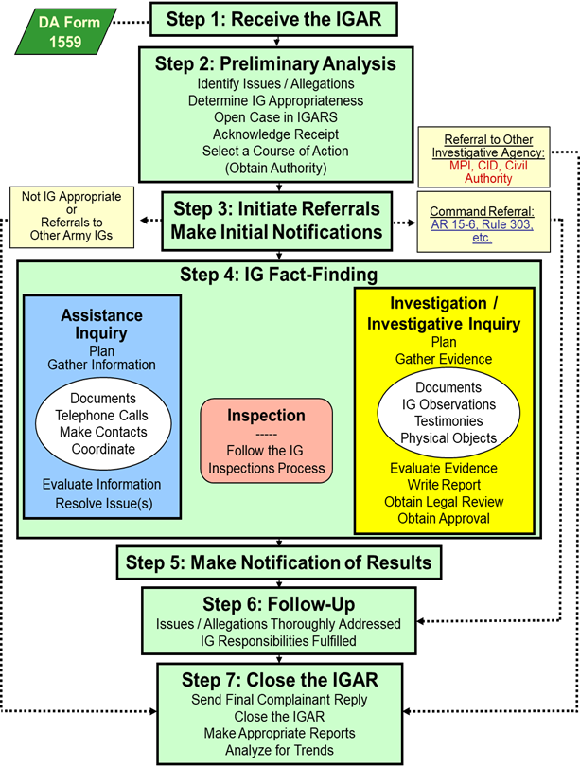
The Seven-Step IGAP
Step One
Step 1 Receive the IGAR
AR 20-1, para. 6-1d (1)
A&I Guide, Part One, Sect. 2-2

Slide 14
The Seven-Step IGAP
Step Two
Step 2 Preliminary Analysis
Identify Issues / Allegations
Determine IG Appropriateness
Open Case in IGARS
Acknowledge Receipt
Select a Course of Action
(Obtain Authority)
AR 20-1, para. 6-1d (2)
A&I Guide, Part One, Sect. 2-3

Slide 15

STEP 2: Conduct IG Preliminary Analysis (IG PA)
A thought process to determine how best to proceed. May take minutes / hours / days
Sub-Steps of Preliminary Analysis
  Identify issues / allegations
  Determine IG appropriateness
  Open the case in IGARS
  Acknowledge receipt
  Select COA
AR 20-1, para. 6-1d (2)
A&I Guide, Part One, Sect. 2-3

Slide 16
STEP 2: Conduct IG PA
Identify Issues / Allegations
  Definitions:
  Issue: C.I.A.
  -- Complaint: expression of dissatisfaction or problem requiring assistance to resolve
  -- Information (RFI)
  -- Assistance: Simple request for help seeking understanding about a process or system
  Allegation: a complaint that lists “who” improperly did / did not do something in violation of a standard
I see an issue.
And here is an
allegation!
A&I Guide, Part One, Sect. 2-3-1

Slide 17
STEP 2: Conduct IG PA
Identify Issues / Allegations
Assistance Function focuses solely on resolving only the issues
IGs must take the time to correctly identify ALL of the issues and / or allegations
(explicitly or implicitly)
IGs should always look for:
  Larger issues
  Implied allegations (even if specifically not mentioned)
  Systemic problems
AR 20-1, para. 6-1d (2) (b)
A&I Guide, Part One, Sect. 2-3-1

Slide 18
STEP 2: Conduct IG PA
Determine IG Appropriateness
If the matter is Army related, you decide:
  What is appropriate for the local IG to work
  Or refer to:
    Chain of command
    Other agencies
    Other IGs
Many matters raised to an IG may not be appropriate for the IG to work
AR 20-1, para. 6-3
A&I Guide, Part One, Sect. 2-3-2

Slide 19
STEP 2: Conduct IG PA
Determine IG Appropriateness
If issue is not IG appropriate:
  Inform the complainant why not appropriate
  Conduct a Warm Hand-Off
  Provide information of appropriate office (contact info, certain formats)
      Example: Army Board for Correction of Military Records (ABCMR) requires submissions on DD Form 149, Application for Correction of Military Record
  Forward to that agency if possible

Slide 20
STEP 2: Conduct IG PA
Determine IG Appropriateness
Do not automatically categorize the whole IGAR as not IG appropriate
Example: “Someone broke the window on my car, took my iPhone and I can’t pay for it because I did not yet receive my travel pay from seven months ago.”
  Refer broken window to Military Police Investigations (MPI) for action
  IG will work the travel-pay issue
Remember to look for systemic issues

Slide 21
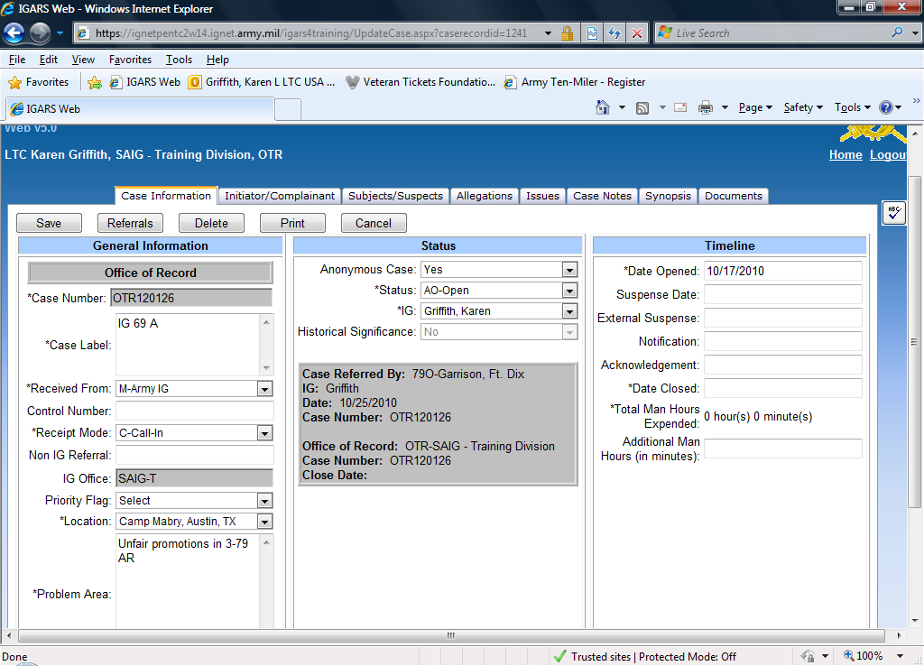
STEP 2: Conduct IG PA
Open the Case in IGARS
ALWAYS Open case in Inspector General Action Request System (IGARS)
  Database
  Used by IGs world-wide
  Information IGAR
  Standard IGAR
  Referrals
AR 20-1, para. 6-1d (2) (j)
A&I Guide, Part One, Sect. 2-3-3

Slide 22
STEP 2: Conduct IG PA
Acknowledge Receipt
Verbal or written
If issue is IG appropriate:
  AND complainant has right to know, inform him or her that you will provide a response
  BUT the complainant is not directly affected: Send a third-party response thanking the individual for his or her concern and telling the person that you will look into the matter
AR 20-1, para. 6-1d (2) (a)
A&I Guide, Part One, Sect. 2-3-4

Slide 23
STEP 2: Conduct IG PA
Select a Course of Action
Inspection
Assistance Inquiry
Investigation
Refer
Inquiry - (DA- Verbal)
or
Investigation – (DA)
A&I Guide, Part One, Sect. 2-3-5

Slide 24
STEP 2: Conduct IG PA
Selection of Course of Action
INVESTIGATIVE INQUIRY
Inspector General
Resolve Allegations
Informal fact-finding process
INVESTIGATION:
Inspector General
Resolve Allegations
Formal fact-finding process (Directing Authority’s directive)
Investigations Block

Slide 25

STEP 2: Conduct IG PA
Selection of Course of Action
IG INSPECTION:
Inspector General
Assistant IG
Focuses on systemic issues
Root Cause
Recommendation for corrections (taskers)
Directing Authority determines scope and content (Directive)
ASSISTANCE INQUIRY:
IG, Assistant, Acting IG
Resolves issues, request for assistance, help, information
Not allegations
An informal fact-finding process

Slide 26
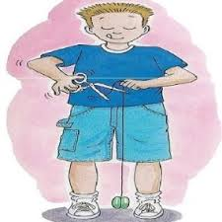
STEP 2: Conduct IG PA
Selection of Course of Action
REFERRAL to:
1. Different Command (refer in IGARS, then close case)
  Equal Opportunity, Equal Employment
  Opportunity
  Criminal Investigations Command
  or Military Police Investigations
  Army Board for Correction of Military
  Records
2. Chain of Command (keep case open and monitor)

Slide 27
The Seven-Step IGAP
Step Two
Step 2 Preliminary Analysis
Identify Issues / Allegations
Determine IG Appropriateness
Open Case in IGARS
Acknowledge Receipt
Select a Course of Action
(Obtain Authority)
AR 20-1, para. 6-1d (2)
A&I Guide, Part One, Sect. 2-3

Slide 28
The Seven-Step IGAP
Step Three
Step 3 Initiate Referrals Make Initial Notifications
AR 20-1, para. 6-1d (3)
A&I Guide, Part One, Sect. 2-4

Slide 29
STEP 3: Initiate Referrals & Make Initial Notifications
Matters that are not IG appropriate
  Refer to the proper agency (Veterans Affairs, Criminal Investigations Division, etc.)
  Close the case
Matters that are not LOCAL IG appropriate
  Refer to the proper IG office (SAIG-IN for Senior Official Allegations)
  Close the case
Exception: Matters referred to the local chain of command
  IG will monitor the case to ensure the chain of command takes proper action
  Then close the case
A&I Guide, Part One, Sect. 2-4-1

Slide 30
STEP 3: Initiate Referrals & Make Initial Notifications
Not making Initial Notifications for Assistance Cases
If allegations, initial notifications are required for subject / suspect and supervisor / commander
Wait for the Investigations block of instruction to hear all about it!
AR 20-1, para. 7-1b (3)
A&I Guide, Part One, Sect. 2-4-2

Slide 31
The Seven-Step IGAP
Step Three
Step 3 Initiate Referrals Make Initial Notifications
AR 20-1, para. 6-1d (3)
A&I Guide, Part One, Sect. 2-4

Slide 32
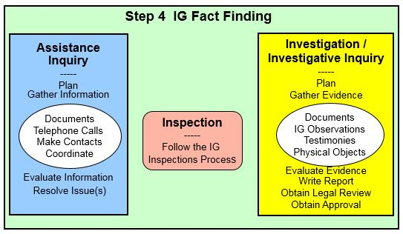
The Seven-Step IGAP
Step Four
A&I Guide, Part One, Sect. 2-5

Slide 33
STEP 4:
Conduct IG Fact-Finding
Authority to conduct “Fact-Finding” for:
  Inspection (Requires Directive from the Directing Authority)
  Assistance Inquiry (No permission needed)
  Investigative Inquiry (Directed by the Command IG or State IG; Verbal Approval from Directing Authority)
  Investigation (Requires Directive from the Directing Authority)
A&I Guide, Part One, Sect. 2-5

Slide 34
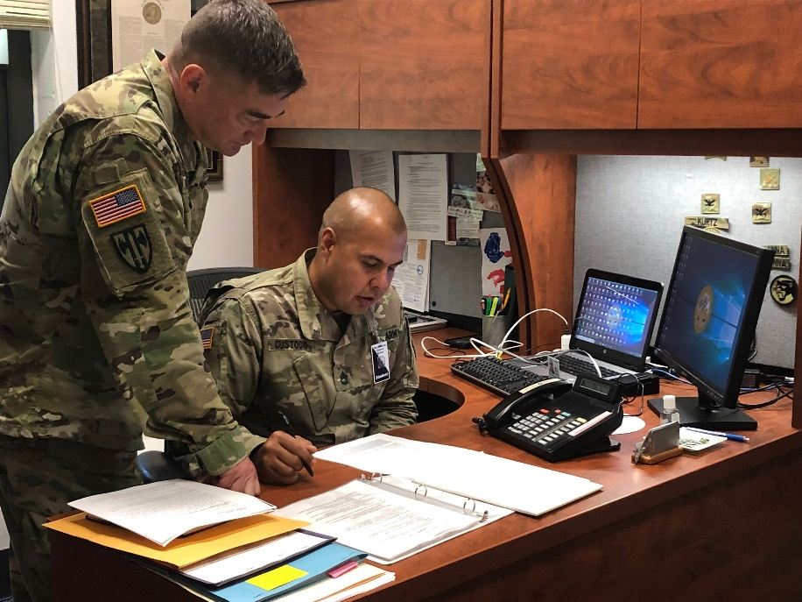
STEP 4:
Conduct IG Fact-Finding
Assistance Inquiry
  Plan
  Confidentiality
  Gather information
    Documents
    Telephone calls
    Fax
    Etc.
  Evaluate information
  Resolve issue(s)

Slide 35
The Seven-Step IGAP
Step Four
A&I Guide, Part One, Sect. 2-5

Slide 36
The Seven-Step IGAP
Step Five
Step 5 Make Notification of Results
AR 20-1, para. 6-1d (5)
A&I Guide, Part One, Sect. 2-6

Slide 37
STEP 5: Make Notification of Results
Informing complainant of results
  Update on the status, may not be final resolution (SITREP)
If IG provided assistance, provide the complainant information pertaining directly to him / her verbally or in writing
Remember third-party and Privacy Act rules!
Notifications need to be annotated in case notes in IGARS database
AR 20-1, 6-1d (5)
A&I Guide Part One, Sect. 2-6

Slide 38
The Seven-Step IGAP
Step Five
Step 5 Make Notification of Results
AR 20-1, para. 6-1d (5)
A&I Guide Part One, Sect. 2-6

Slide 39
The Seven-Step IGAP
Step Six
Step 6 Follow-Up
Issues / Allegations Thoroughly Addressed
IG Responsibilities Fulfilled
AR 20-1, para. 6-1d (6)
A&I Guide, Part One, Sect. 2-7

Slide 40

STEP 6: Conduct
Follow-up
IG can contact complainant, the complainant can contact the IG, or the IG can address in a future inspection
  Ensure issues were thoroughly
  addressed
  Ensure all IG responsibilities are
  fulfilled
AR 20-1, para. 6-1d (6)
A&I Guide, Part One, Sect. 2-7

Slide 41
The Seven-Step IGAP
Step Six
Step 6 Follow-Up
Issues / Allegations Thoroughly Addressed
IG Responsibilities Fulfilled
AR 20-1, para. 6-1d (6)
A&I Guide, Part One, Sect. 2-7

Slide 42
The Seven-Step IGAP
Step Seven
Step 7 Close the IGAR
Send Final Reply
Close the IGAR
Make Appropriate Reports
Analyze for Trends
AR 20-1, para. 6-1d (7)
A&I Guide, Part One, Sect. 2-8

Slide 43
STEP 7: Close the IGAR
Provide complainant a final reply
Close the file in IGARS database
Make appropriate reports
Analyze developing trends
AR 20-1, para. 6-1d (7)
A&I Guide, Part One ,Sect. 2-8

Slide 44
STEP 7: Close the IGAR
Final Reply to Complainant
Dear COL Saunders,
This responds to
your January 5, 2023
letter to the IG . . .
Prepare a response to the complainant:
  Address the complaint
  Summarize the facts and conclusions that pertain to the complainant
  Maintain confidentiality
Annotate in IGARS case file
Excellent opportunity to Teach and Train
A&I Guide, Part One, Sect. 2-8-1

Slide 45
STEP 7: Close the IGAR
Final Reply to Complainant
(continued)
Replies normally will not contain:
  Classified information
  Information / documents from outside agencies without their permission
  Identity of sources or techniques used
  All information surfaced
  Results of disciplinary action
  Information that violates privacy of others

Slide 46
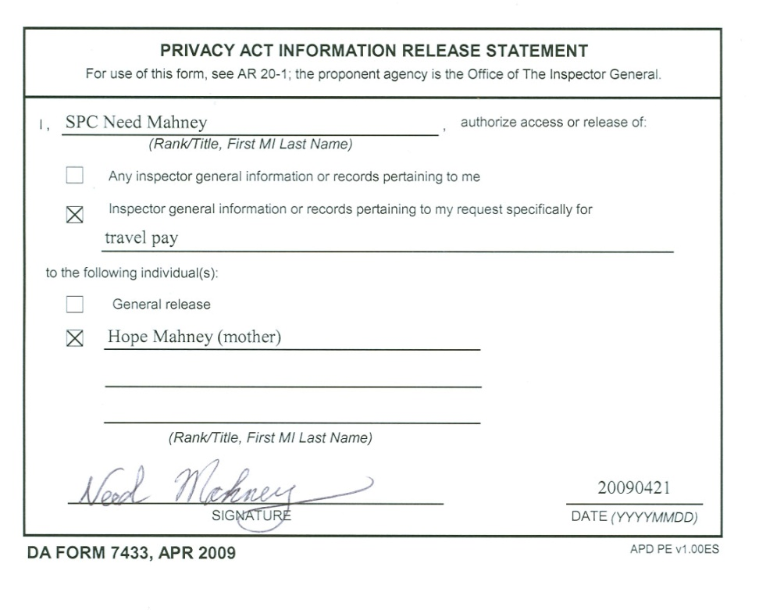
STEP 7: Close the IGAR
Final Reply to Complainant
(continued)
ELO
4
Third-party complaint
  Privacy Act release
  No right to know results if the issues do not directly pertain to complainant
  The IG must have a
  DA Form 7433 signed by
  the complainant
  before releasing inquiry
  results to a third party

Slide 47
STEP 7: Close the IGAR
Close the File in IGARS
Function code that best describes each issue or allegation
  Be as specific as possible
  Accurate entries make the database useful and the information gleaned from it meaningful
Agency / Command Codes
  Location of the allegation, issue, or complaint
  If your CG can’t fix it, don’t use your command code
AR 20-1, para. 6-1d (7)
A&I Guide, Part One, Sect. 2-8-2

Slide 48
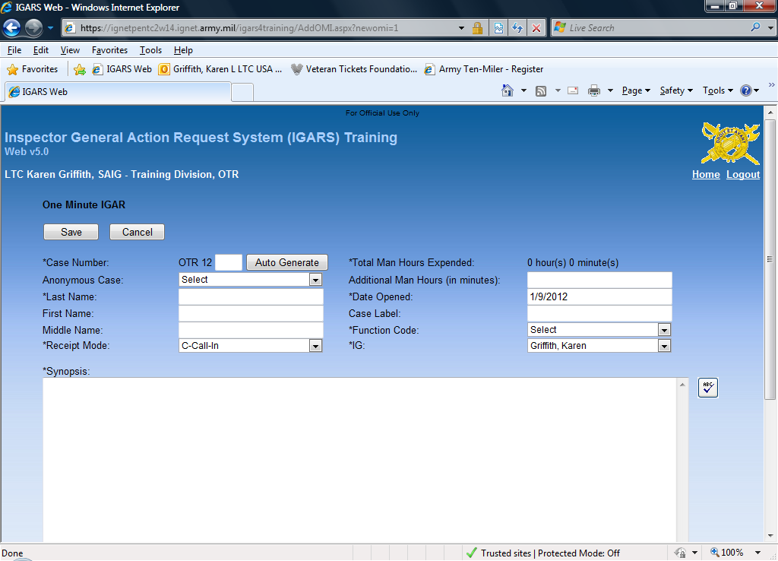
STEP 7: Close the IGAR:
Information IGAR
(continued)
Requests for Information
and IG-to-IG Support
Document man-hours for
IG-Staff coordination and
Inspections
Opened / Closed on
same day
Single screen input
Cannot be converted to
a Standard IGAR
If the issue has an associated
Function code, use a Standard IGAR

Slide 49
STEP 7: Close the IGAR
Close the File in IGARS
(continued)
Determination Codes: A, F, U, S, N, CS, CN
  Issues use A – Assistance, F – Founded, or U - Unfounded
  A - Assistance. Use the conclusion “assistance” when the IG provided advice, offered guidance, or resolved the request for assistance.
  Referral to an agency other than the IG to resolve the problem. For example, an allegation that the IG refers to CID.

Slide 50
STEP 7: Close the IGAR
Close the File in IGARS
(continued)
Determination Codes: A, F, U, S, N, CS, CN
  F - Founded. Use the conclusion “founded” when the complaint has merit and required resolution.
  U - Unfounded. Use the conclusion “unfounded” when the complaint does not have merit and there was no evidence that a problem existed for the IG to resolve.

Slide 51
STEP 7: Close the IGAR
Close the File in IGARS
(continued)
Determination Codes: A, F, U, S, N, CS, CN
  Allegations:
  S – SUBSTANTIATED
  Use the conclusion “substantiated” when a preponderance of credible evidence exists to prove the allegation.
  N – NOT SUBSTANTIATED
  Use the conclusion “not substantiated” when a preponderance of credible evidence does not exist to prove the allegation.
Investigations Block

Slide 52
STEP 7: Close the IGAR
Close the File in IGARS
(continued)
Determination Codes: A, F, U, S, N, CS, CN
  Allegations:
  CS – COMMAND SUBSTANTIATED
  Use the determination code “CS” when the command product of a command referred allegation(s) prove the allegation.
  CN – COMMAND NOT SUBSTANTIATED
  Use the determination code “CN” when the command product of a command referred allegation(s) does not exist to prove the allegation.
Investigations Block

Slide 53
STEP 7: Close the IGAR
Close the File in IGARS
(continued)
Finish Case notes
A chronological listing of a case history used to identify fully the complainant, the allegations, issues, or assistance requested; the subject / suspect of the allegations; the actions taken in resolving the case (POCs, phone numbers, notifications, etc.); and the final outcome.
Start each entry with the date and the action officer’s name
For Example:
A&I Guide Part One, Sect. 2-3-3

Slide 54
Example of Case Notes
5/12/2022 (LTC Sisak): SPC Toni Nissan, active component, assigned to the 66th PSB, Fort Von Steuben, visited this office and requested assistance to have her household goods delivered. SPC Nissan PCS’ed from Germany more than three months ago and has not received her HHGs. SPC Nissan completed a DA Form 1559 and retained a copy for her records. She provided a copy of her orders, shipping documents, and a chronology of the events to date related to this issue. SPC Nissan was briefed on the Privacy Act and consented to the release of her personal information in order to get this matter resolved.

Slide 55
STEP 7: Close the IGAR
Close the File in IGARS
(continued)
Complete Synopsis
  “Executive Summary”
  Stand-alone document
  Who, what, when, where, and how
  Four Part format / template
  Final Determination
A&I Guide, Part One, Sect. 2-8-2

Slide 56
STEP 7: Close the IGAR
Make Appropriate Reports
These reports are covered in your local Standing Operating Procedures (SOP)
AR 20-1, para. 6-1d (7)
A&I Guide, Part One, Sect. 2-8-3

Slide 57
STEP 7: Close the IGAR
IGAR Analysis
Trends
  Look for both positive and negative trends
  Ensure all IGs are coding similar cases with same function codes
  Look for seasonal trends
Systemic issues
  Office workload
  Source of IGARs
  Most frequent function codes
  Most substantiated function codes
A&I Guide, Part One, Sect. 2-8-4

Slide 58
STEP 7: Close the IGAR
If complainant is not satisfied with response:
  Reexamine inquiry and response for completeness at local level
  Refer to next higher IG
  Don’t take it personally!!
AR 20-1, para. 6-1d (7) (d)

Slide 59
The Seven-Step IGAP
Step Seven
Step 7 Close the IGAR
Send Final Reply
Close the IGAR
Make Appropriate Reports
Analyze for Trends
AR 20-1, para. 6-1d (7)
A&I Guide, Part One, Sect. 2-8

Slide 60
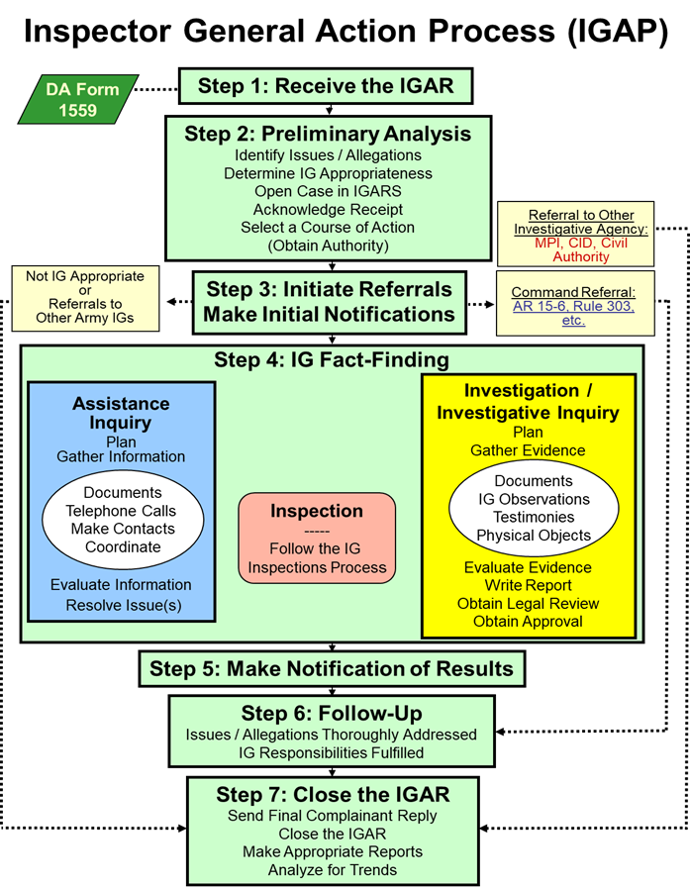
Inspector General Action Process (IGAP)
ELO
3
A&I Guide, Part One,
Chapter 2

Slide 61
Summary
ELO 3. Describe the seven-step Inspector General Action Process (IGAP) used to receive, process, and resolve Inspector General Action Requests (IGARs).
ELO 13. Describe the process of receiving an IGAR by conducting an interview,
completing a
DA Form 1559 (IGAR),
asking the fundamental
questions,
advising the complainant of the Privacy Act,
and protecting confidentiality.

Slide 62
Case Example - Nissan
STEP 1: Receive the IGAR
Conduct the interview
Complete DA Form 1559

Slide 63
Case Example - Nissan
STEP 2: Conduct IG PA
Issues:
Allegations:
IG Appropriate:
Open Case in IGARS:
Acknowledge Receipt:
COA:
Household goods delivery
None
Yes
During EPE
See Letter
Assistance Inquiry

Slide 64
Case Example - Nissan
STEP 3: Initiate Referrals & Make Initial Notifications
For this Assistance Inquiry: None

Slide 65
Case Example- Nissan
STEP 4: Conduct IG
Fact-Finding
Call Fort Von Steuben (FVS) Transportation Office:
SPC Nissan’s household goods are due to arrive at Fort Von Steuben this week and should be delivered by end of next week.

Slide 66
Case Example - Nissan
STEP 5: Make Notification of Results
Call SPC Nissan:
Household goods just arrived and should be delivered by the end of next week.

Slide 67
Case Example - Nissan
STEP 6: Conduct Follow-up
Call SPC Nissan to see if household goods were delivered.
Ensure issues were thoroughly addressed
Ensure all IG responsibilities are fulfilled

Slide 68
Case Example - Nissan
STEP 7: Close the IGAR
Send final reply
Close case in IGARS
Make appropriate reports
Analyze for trends / systemic issues
See Letter
Function Code – 34D (Personal Property Movement)
Determination Code -- A (Assistance)
IG Command Code -- OTR (Fort Von Steuben)
Case Notes
Synopsis

Slide 69
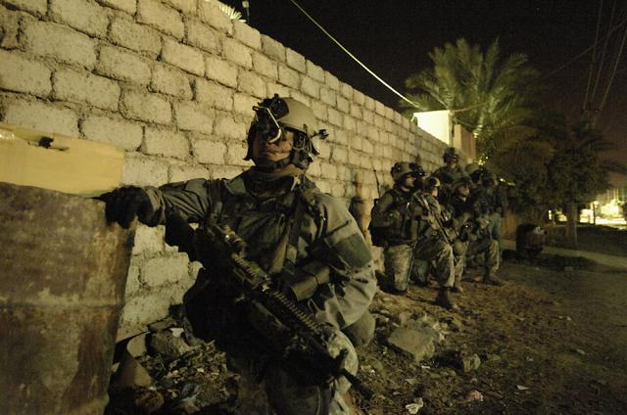
Questions?

